Slide 1
VIDEO AND VIDEO COMPRESSION
Dr. Quang Duc Tran

Slide 2
Analog Video
A video signal is a sequence of two dimensional (2D) images projected from a dynamic three dimensional (3D) scene onto the image plane of a video camera.
A video records the emitted and/or reflected light intensity from the objects. The intensity changes both in time and space.

Slide 3
Composite vs. Component Video
Ideally, a color video is specified by three function or signals, each describing one color component. A video in this format is known as component video.
In composite video, the three color signals are multiplexed into a single signal. A composite signal has bandwidth that is significantly lower than the sum of the bandwidth of three component signals, and hence, can be stored and transmitted efficiently. This is achieved at the expense of video quality.
S-video consists of two components, the luminance component and a single chrominance component.

Slide 4
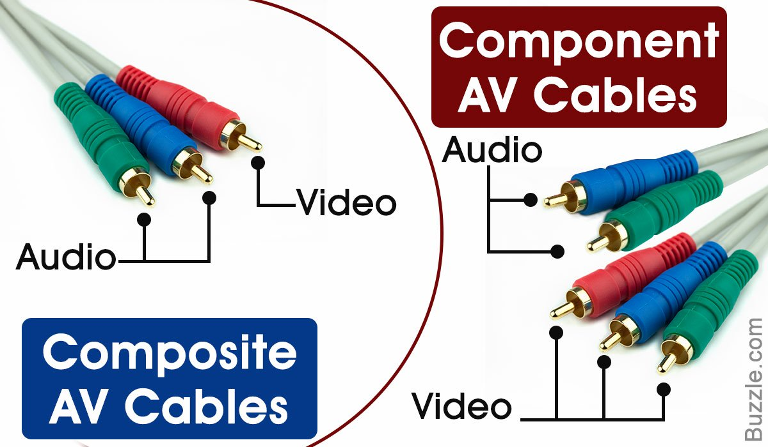
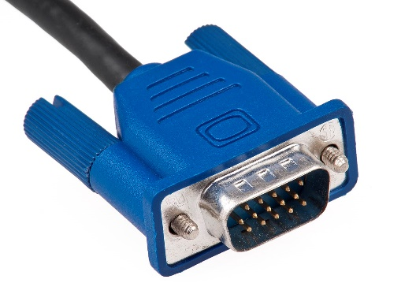
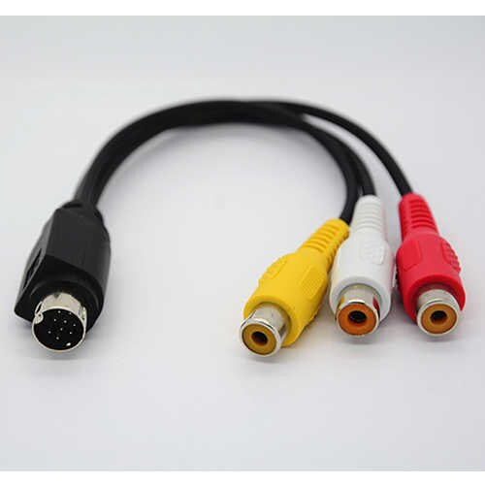
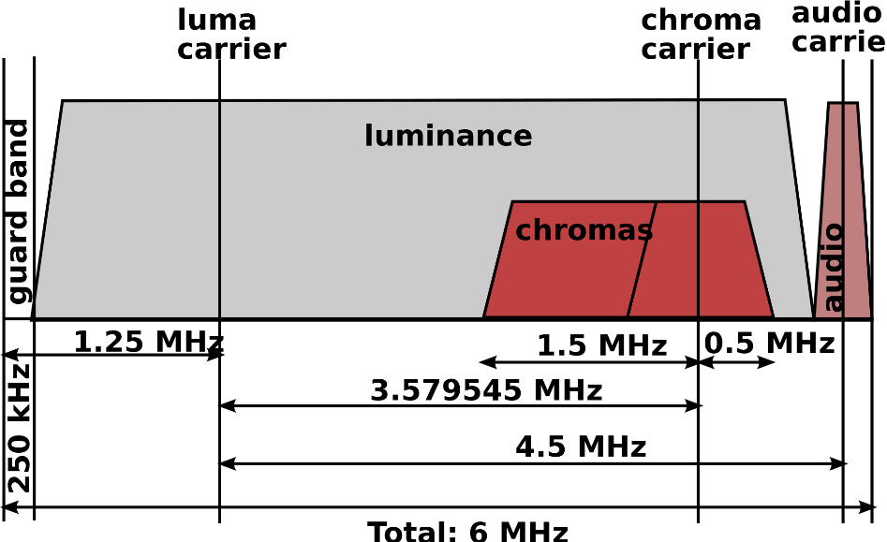
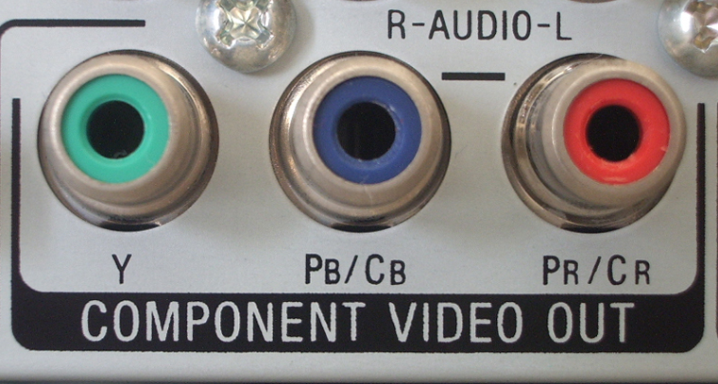
Composite vs. Component Video

Slide 5
Analog Video Raster
The analog TV systems of today use raster scan for video capture and display, which can be interlaced or progressive.
The progressive scanning scans an image sequentially from line 1 to the final line of the raster to create a video frame.
The interlaced scanning scans odd lines in field 1 and even lines in field 2. Together field 1 and 2 constitute one frame.

Slide 6
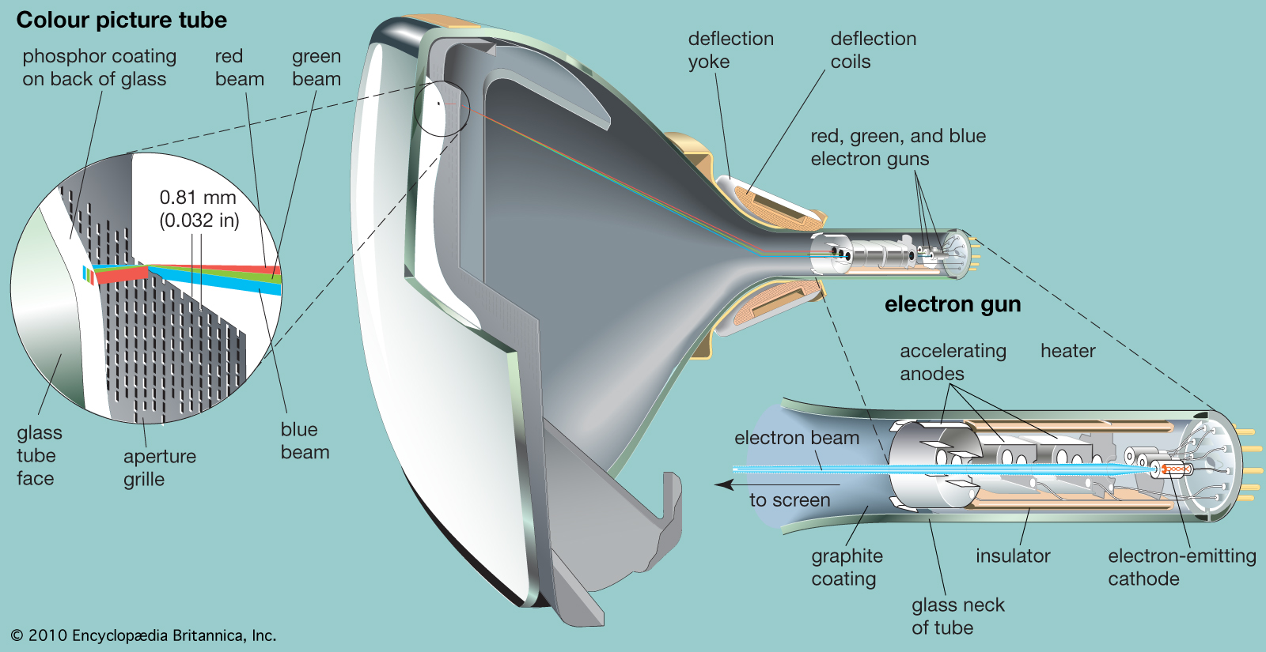
Analog Video Raster

Slide 7
Refresh rate
The frequency between the display of two still images is known as the refresh rate and is expressed in Hz or frames per second.
The movie industry uses a refresh rate of 24 frames per second.
For a fix bandwidth, the interlaced scan provides a video signal with twice the display refresh rate for a given line count as compared to the progressive scan. This higher refresh rate improves the appearance of objects motion.
However, interlaced scan causes interlacing effects if recorded objects move fast to be in different positions when each individual field is captured.

Slide 8
Analog Television System
HDTV enhances the visual impact by employing a wider screen (16:9) and sampling resolution of 60 frames/s, and 720 line/frame.
For computer display, much higher temporal and spatial sampling rates are needed (e.g., SVGA has 72 fps and a resolution of 1024x720 pixels).
Parameters | NTSC | PAL | SECAM
Field Rate | 59.94 | 50 | 50
Line No./Frame | 525 | 625 | 625
Line Rate (Line/s) | 15,750 | 15,625 | 15,625
Luminance Bandwidth (MHz) | 4.2 | 5.0, 5.5 | 6.0
Chrominance Bandwidth (MHz) | 1.5 (I), 0.5 (Q) | 1.3 (U,V) | 1.0 (U,V)
Audio Subcarrier | 4.5 | 5.5, 6.0 | 6.5
Composite Signal Bandwidth (MHz) | 6.0 | 8.0, 8.5 | 8.0

Slide 9
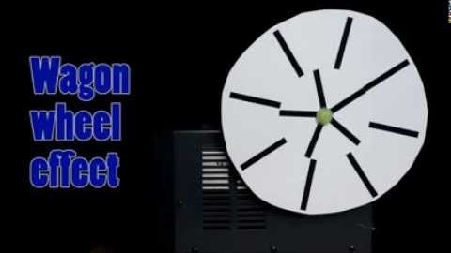
Wagon-wheel effect

Slide 10
Digital Video
A digital video can be obtained either by sampling a raster scan, or directly using digital video camera.
In the BT. 601 standard, a sampling rate of 13.5 MHz is used for both the NTSC and PAL/SECAM systems.
BT.601 also defines a digital color coordinate, known as YCbCr (see Chroma Sub-sampling).
In addition to BT.601, other standards exists. For example, CIF (Common Intermediate Format) has about half the resolution of BT.601.

Slide 11
Video Compression
International Telecommunication Union (ITU-T)
H.261: ISDN Video Phone (px64 kb/s)
H. 263: PSTN Video Phone (<64 kb/s)
H.26L: A variety of applications (<64 kb/s)
Internet Video Application, VOD, Video Mail
International Organization for Standard (ISO)
MPEG-1 Video: CD-ROM (1.2 Mb/s)
MPEG-2 Video: SDTV, HDTV (4-80 Mb/s)
MPEG-4 Video: A variety of applications (24-1024 kb/s)
MJEG (Moving JPEG) applies JPEG algorithm to each frame independently.

Slide 12
Video Compression (Cont.)
A video stream has 2 spatial and 1 temporal dimensions, video compression is usually done independently in the spatial dimensions and, respectively, in the time dimension.
In the spatial dimensions – encoder tries to eliminate spatial redundancy (like in JPEG) and typically works on 8x8 pixel image blocks.
In the time dimension – encoder tries to eliminate temporal redundancy (i.e. motion of objects) and typically works on 16x16 pixel image blocks.

Slide 13
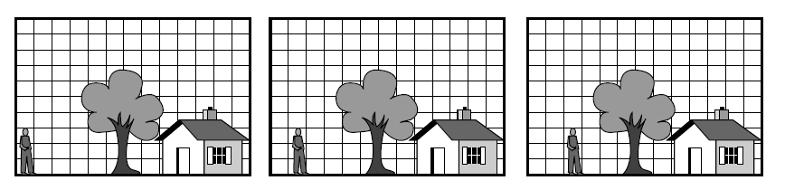
Motion Estimation
The references between the different types of frames are realized by a process called motion estimation. The correlation between two frames in terms of motion is represented by a motion vector.

Slide 14
Motion Estimation (Cont.)
Good estimation of the motion vector results in higher compression ratios and better quality of the coded video sequence.
The actual frame is divided into non-overlapping blocks (macro blocks) usually 16x16 pixels. The smaller the block sizes are chosen, the more motion vectors need to be calculated.
Motion vectors are only calculated if the difference between two blocks at the same position is higher than a threshold.

Slide 15
Motion Estimation (Cont.)
Block Matching tries to “stitch together” an actual predicted frame by using blocks from previous frames.
Each blocks of the current frame is compared with a past frame within a search area.
Rectangular search area is used, which takes into account that horizontal movements are more likely than vertical ones.
Only luminance information is used to compare the blocks, but color information will be included in the encoding.

Slide 16
Motion Compensation
Video motions are often complex. A simple “shifting in 2D” is not a perfectly suitable description of the motion in the actual scene, causing so called prediction errors.
Since the estimation is not exact, additional information must also be sent to indicate any small differences between the predicted and actual positions of the moving segments involved. This is known as the motion compensation.
Generally, less data is needed to store the differences.

Slide 17
Schematic Process of Motion Estimation
Current
Frame
DCT
Quantization
Entropy
Coding
Bit stream
Motion Compensation
Reference
Frames
Frame N-1
Motion Estimation
Frame N
Motion Vector

Slide 18
MPEG Standards
MPEG-1: Initial Audio/Video Compression Standard
Total bit rate: 1.5 Mbps
Video: 352x240 pixels/frame, 30 frames/s
Audio: 2 channels, 48,000 samples/s, 16 bits/sample
MPEG-2: for better quality audio and video
Total bit-rate: 4-80 Mbps
Video: 720x480 pixels/frame, 30 frames/s
Audio: 5.1 channels, Advanced Audio Coding (AAC)
MPEG-4: for a variety of applications with a wide range of quality and bit rate

Slide 19
A Typical MPEG Frame Display Order
Forward Motion Compensation
I
B
B
P
B
B
P
B
B
I
Bidirectional Motion Compensation
I-frame: Intra-coded frame
P-frame: One directional motion prediction from a previous frame
B-frame: Bi-directional motion prediction from a previous or future frame

Slide 20
I-frames
I-frames are encoded without reference to any other frames. Each frame is treated as a separate picture and the Y, C_{b} and C_{r} matrices are encoded separately using JPEG
I-frames must be repeated at regular intervals to avoid losing the whole picture as during transmission it can get corrupted and hence looses the frame
The number of frames/pictures between successive I-frames is known as a group of pictures (GOP). Typical values of GOP are 3 - 12

Slide 21
P-frames
The encoding of the P-frame is relative to the contents of either a preceding I-frame or a preceding P-frame
P-frames are encoded using a combination of motion estimation and motion compensation
If the two contents are the same, only the address of the macro block in the reference frame is encoded
If the two contents are very close, both the motion vector and the difference matrices associated with the macro block in the reference frame are encoded.
If no close match is found, then the target macro block is encoded in the same way as a macro block in an I-frame
Number of P frames between I-frames is limited to avoid error propagation

Slide 22
B-frames
Motion estimation works well in slow moving applications like video telephony
For fast moving video it will not work effectively. Hence B-frames (Bi-directional) are used. Their contents are predicted using the past and the future frames
B-frames provides highest level of compression and because they are not involved in the coding of other frames they do not propagate errors

Slide 23
MPEG-1 Encoder

Slide 24
MPEG-1 Decoder

Slide 25
MPEG-1 Performance
Compression for I-frames are similar to JPEG for Video typically 10:1 through to 20:1 depending on the complexity of the frame contents
P and B frames are higher compression and in the region of 20:1 through to 30:1 for P frame and 30:1 to 50:1 for B-frames

Slide 26
MPEG-1 Bit stream structure
Video sequence #n-1
Video sequence #n
Video sequence #n+1
Sequence
Header
GOP #p
GOP #p+1
GOP #p+2
GOP #p+3
GOP #p+4
GOP #p+5
GOP
Header
Frame I
Frame B
Frame B
Frame P
…
Frame
Header
MB
MB
MB
MB
MB
MB
MB
MB
MB
MB
MB
MB
MB
MB
Slide
Header
Motion Vector
Block Y
Block Y
Block Y
Block Y
Block C_{b}
Block C_{r}
MB
Header

Slide 27
MPEG-2 Standard
MPEG-2 is a higher-quality video coding standard at a bit rate of more than 4 Mbps for video on demand (VOD), standard definition (SD) and high-definition (HD) digital TV broadcasting and for storing video on digital storage media like the DVD
MPEG-2 supports interlaced video and alternative scan order.
MPEG-2 have scalable coding and include error resilience techniques

Slide 28
MPEG-2 Interlaced Scan
Progressive Scan
Interlaced Scan

Slide 29
MPEG-2 Alternative Scan Order
Zigzag scan
Alternate scan
Alternative scan order may improves the effectiveness of DCT on prediction errors. This is due to the fact that in interlaced video, the consecutive rows in the blocks are from different fields. Hence there is less correlation between them than between the alternative rows.

Slide 30
MPEG-2 Scalable Coding
Scalable coding divides the audio-video stream into a base layer and some enhancement layers
When the base layer is decoded basic quality is achieved, but if the transmission channel allows it, decoding enhancement layers brings additional quality to the decoded stream.
The types of scalability can be SNR scalability, spatial scalability, temporal scalability or hybrid (combination of the above).

Slide 31
SNR Scalability
At the Base Layer, a coarse quantization of the DCT coefficients is employed which results in fewer bits and a relatively low quality video.
The coarsely quantized DCT coefficients are then inversely quantized and fed into the Enhancement Layer to be compared with the original DCT coefficients.
Their difference is finely quantized to generate a DCT coefficient refinement.

Slide 32
SNR Scalability
DC coefficient: +3 → (2),(3)
AC coefficients:
(0,2) (-3)
(1,2) (-3)
(0,2) (-2)
(0,3) (-6)
(0,2) (2)
…
(0,0) → EOB
AC coefficient is made up of a pair of symbols (run length, size) (amplitude). Run length is the number of zeros in the run. Size is the number of bits used to encode amplitude.
-26 | -3 | -6 | 2 | 2 | -1 | 0 | 0
0 | -2 | -4 | 1 | 1 | 0 | 0 | 0
-3 | 1 | 5 | -1 | -1 | 0 | 0 | 0
-4 | 1 | 2 | -1 | 0 | 0 | 0 | 0
1 | 0 | 0 | 0 | 0 | 0 | 0 | 0
0 | 0 | 0 | 0 | 0 | 0 | 0 | 0
0 | 0 | 0 | 0 | 0 | 0 | 0 | 0
0 | 0 | 0 | 0 | 0 | 0 | 0 | 0

Slide 33
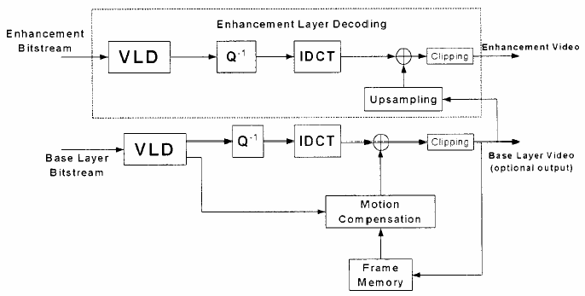
Spatial Scalability
The Base Layer is designed to generate bitstream of reduced resolution pictures. When combined with the enhancement layer, pictures at the original resolution are produced.
Image from Base Layer is up-sampled and supplemented by Enhancement Layer.

Slide 34
Temporal Scalability
Temporal scalability provides different frame rate video.
The Base Layer yields the basic lower frame rate.
Higher rate video is obtained by decoding additional pictures in the data stream using temporal prediction with reference to the Base Layer pictures.

Slide 35
MPEG-4 Standard
MPEG-4 is used for interactive multimedia applications over the Internet and over various entertainment networks.
MPEG standard contains features to enables the manipulation of the individual elements that make up a scene within a video.
In MPEG-4 each video frame is segmented into a number of video object planes (VOP) each of which will correspond to an AVO (Audio visual object) of interest.

Slide 36
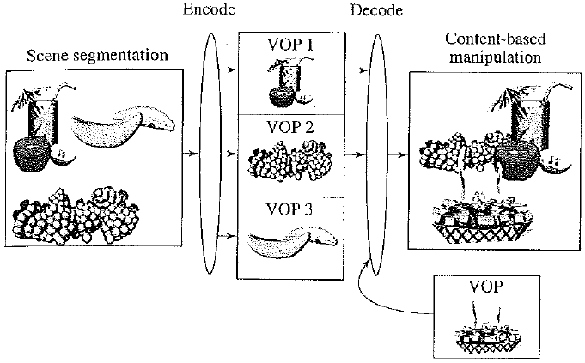
MPEG-4 Standard (Cont.)
VOP is a time sample of a video object. VOPs can be encoded independently of each other or dependent on each other by using motion compensation.
The VOP carries the shape, motion and texture information that defines the video object at a particular instant in time.

Slide 37
MPEG-4 Standard (Cont.)
Each audio and video object has a separate object descriptor associated with it, which allows the object to be manipulated by the viewer prior to it being decoded and played out.
Before being compressed each scene is defined in the form of a background and one or more foreground audio-visual objects (AVOs).
The audio associated with an AVO is compressed depending on the available bit rate of the transmission channel and the sound quality required.

Slide 38
MPEG-4 Standard (Cont.)
Transmission Multiplexer
VOP 0 encoding
VOP
Identification + Definition
VOP 1 encoding
Video Input
VOP 2 encoding
Audio Input
Audio encoding

